Slide 1

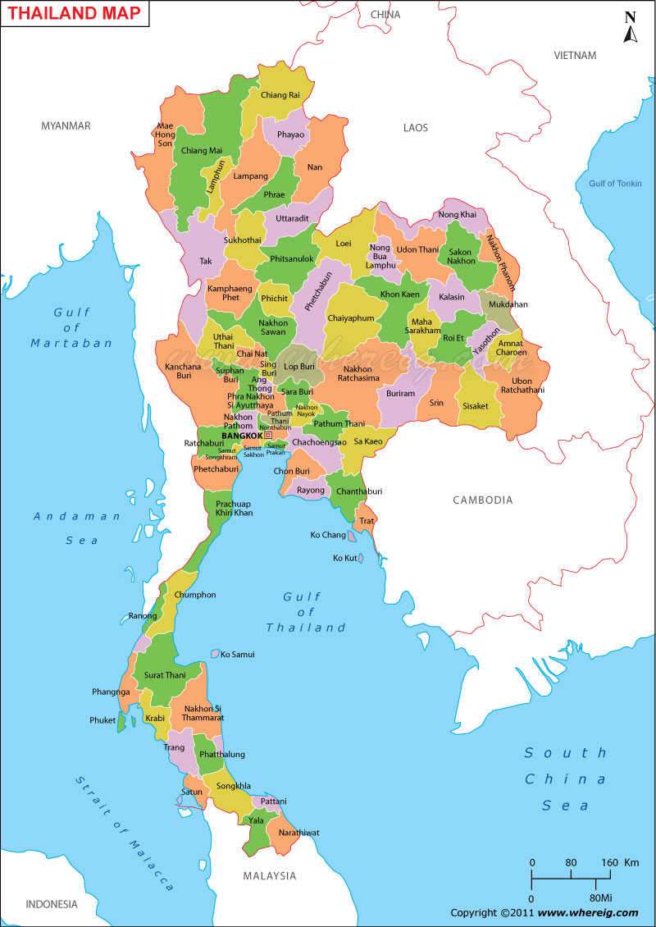
General Market Information
№ | Parameterer | Thailand
1 | Population (million) | 67.2
2 | Labor force ratio | 59.3%
3 | Unemployment rate | 1%
4 | GDP per capita | $5.7K
5 | GDP growth (07.2016 to 07.2015) | 3.6%
6 | Household debt to GDP | 71.3%
7 | Average Monthly income | $395
8 | Mobile phone penetration (inc. smartphones) | 146%
9 | Smartphone penetration (out of total population) | 59.7%
10 | Internet users penetration (inc. mob. broad band) as of 2015 | 56%
11 | Facebook accounts penetration (out of total population), as of 2016 | 52.2%
12 | Bank accounts penetration (out of total population), as of 2015 | 72%
13 | ATMs per 100 000 adults, as of 2015 | 112
14 | Bank branches per 100 000 adults, as of 2015 | 12.7
15 | Credit card penetration | 5.5%
16 | Online banking penetration | 43%
Official languages: Thai
Most populous cities:
Bangkok – 8.4 mln
Nonthaburi – 0.27 mln
Nakhon Ratchasima – 0.17 mln
Chiang Mai – 0.17 mln
http://web.nso.go.th/
http://data.worldbank.org/
http://www.tradingeconomics.com/thailand/indicators

Slide 2
Consumer Finance Industry Landscape 1/2
The first bank in Thailand (HSBC) was established in 1888. The first Thai Bank - Siam Commercial Bank (SCB) was established in 1906. Bank of Thailand (BOT) was established in 1942 during WW2. The first pawnshop in Thailand was established in 1866 by Thai – Chinese citizen. The first pawnshop regulation was issued in 1962, the latest - in 2008.
Nowadays the formal lending sector in Thailand consists of:
30 Banks (15 Thai banks, 4 Subsidiaries of Foreign banks ,11 Foreign bank branches), 8 Specialized Financial Institutions
35 Personal Loan companies, 21 Nano Finance companies, 10 Credit card companies
598 registered pawnshops
Initially Personal loan (PL) companies were regulated by Commercial Act. In 2005 BOT started to regulate the PL business due to complains from many customers: PL companies were charging interest over 15% allowed by Commercial Act. The BOT targets were to control the interest cap and to minimize the loan sharks influence. Next parameters were launched:
The max Effective interest rate - 28% per year (15% Interest rate + 13% Fee)
Maximum loan amount - not more than 5 times of borrowers income, PL company has to verify the income
But low interest cap and official income prove allowed the PL companies to cover only medium plus income borrowers with official income. Large portion of demand from low income and unofficially employed & self employed customers were still covered by pawnshops and loan sharks.
In general only upper segment is eligible for bank loans. Middle class, if does not possess sufficient security, ask guarantors’ support predominantly in case of emergency. There is no financial accommodation to satisfy everyday needs and facilitate consumption.

Slide 3
Consumer Finance Industry Landscape 2/2
In 2015 BOT decided to make next step against illegal lending - the Nano Finance (NF) regulation was issued. The target customers for NF - Individuals, e.g. new business owners, who may not have constant monthly income, monthly paycheck, or financial history but are capable of repaying loans. Next parameters were launched:
The max Effective interest rate - 36% per year
Maximum loan amount – USD 2830
There were expectations that within the initial two to three years of the NF scheme, NF’s loans will amount 1 to 1,7 bln USD. After 1st year (Feb 15- Jan 16) the total loan amount issued by NF companies is only 7.3 mln USD
Ministry of Finance (MOF) is planning to launch Pico Finance (PF) to help the poor out of heavy debts from loan sharks. Under the MOF idea, it will employ ‘Pico Finace’ and ‘Nano Finance’ to handle loans at rural level. PF will handle smaller cases and with loans not exceeding USD 1415 whereas NF will handle larger loans up to USD 2830. In both loans, interest charge must not exceed 36% per year
There are 3 types of Pawnshop in Thailand : 1. Pawnshop owned by Private company (currently is difficult to get the new license from government) 2. Pawnshop that is owned and operated by Department of Local Administration 3. Pawnshop own by Local Administration in each province (funding by local administration each province).
The pawnshop is still favorite place for low income customers who need money. If lowthey have no pledge only one way to borrow money is from loan sharks lender which are often rich or influential people in each area

Slide 4
Licensing Options
Parameters | Thai Commercial Bank | Specialized Financial Institutions | Personal Loan Company | Nano-Finance Company | Pawnshop | P2P (No license yet)
Main purpose | Full range lending for corporate & personal lending | State-owned 1) promoting economic development 2) supporting investment | Medium to long term loan | Granting loan to grass root class | Secured loans with items of personal property used as collateral | Unsecured loan to SME
Minimum paid-up capitalization | N/A | N/A | USD 1.39 million | USD 1.39 million | USD 0.1 million | USD 0.15 million
Max foreign capital share | <50% List 3 Business | <50% List 3 Business | <50% List 3 Business | <50% List 3 Business | <50% List 3 Business | Thai incorporated company
Interest cap | N/A | N/A | Max EIR 28% include Coll fee | Max EIR 36% include Coll fee | Max 24% (LA < $57) Max 15% (LA > $57) | N/A
Regulator | Ministry of Finance The Bank of Thailand | Ministry of Finance The Bank of Thailand | Ministry of Finance The Bank of Thailand | Ministry of Finance The Bank of Thailand | Pawnshop Committee | Bank of Thailand Securities & Exchange Commission
Tenure for getting license | N/A | N/A | 60 days to approve by regulators | 60 days to approve by regulators | 45 days to approve by regulator | SEC Office (Form 35-FP)
Number of active licenses | 30 | 8 | 35 | 21 | 598 | 0
It is possible for foreign company to incorporate a subsidiary company in
Source: https://www.bot.or.th/English/FinancialInstitutions/FIStructure/Pages/default.aspx

Slide 5
Personal Loan Companies. Product parameters
 | Parameter | AEON PL | KTC | EASY BUY
1 | Acquisition Channel | Branch / Direct sales By Post Online | Branch / Direct sales By Post Online | Branch / Direct sales By Post Online / Mobile App
3 | Loan amount, USD | 91 – 3,030 | 454 – 90,909 | 212 – 6,060
4 | Avg Loan amount, USD | 1,363 | 2,121 | 1,515
5 | Tenure, month | 12-60 | 12-60 | Revolving cash card
6 | Handling fee | 13% | 13% | 13%
7 | Interest rate, per annum | 15% | 15% | 15%
8 | Stamp duty fee | The actual cost incurred | KTC paid for customer | The actual cost incurred
 | Time –To-Cash
9 | Late payment fee (Max USD12.9 req. by BOT) | 3 USD./billing Cycle | 3 USD./billing Cycle | 3 USD./billing Cycle
10 | Early loan repayment | Applicable | Applicable | Applicable
11 | Early repayment penalty | No | No | No
12 | Repayment Channels | AEON branch, ATM Bank: ATM, online, direct debit Payment Partners | KTC Branch Bank: ATM, online, direct debit Payment Partners | Easy Branch, ATM Bank: ATM, online, direct debit Payment Partners
13 | Website | http://www.aeon.co.th | http://www.ktc.co.th | http://www.easybuy.co.th
14 | # DSA | 1,500-1,800 | 1,000 -1,200 | 800-900

Slide 6
Personal Loan Companies. Borrower requirements
 | Items | AEON PL | KTC | EASY BUY
1 | Target Segment | Age 20-65 Income >150 USD | Age 20-55 Income >450 USD | Age 20-55 Income >215 USD
2 | Age | 20 - 65 | 20-55 | 20-55
3 | Citizenship | Thai only | Thai only | Thai only
 | Min Income, USD | 150 | 450 | 215
 | Min tenure on last workplace | 6 months | 4 months (Past probation) | 4 months (Past probation)
4 | ID | Copy of ID Card | Copy of ID Card | ID card or Copy of ID (If apply by mail)
5 | Residential Proof | Copy of Household Registration | Copy of Household Registration | Copy of Household Registration
6 | Income prove | Latest Income slip | Latest Income slip | Latest Income slip within 2 months
7 | Bank Statements | 6 Months | 3 Months | 3 Months
8 | Bank Account | Copy of book bank with account No | Copy of book bank with account No | Copy of book bank with account No
9 | NCB fee | $0.34 per hit / $0.14 per no hit | No | No
10 | Additional Requirement | Home & office Telephone | Home or office Telephone | Home or office Telephone
*Foreigner refers expat with working visa

Slide 7
National Credit Bureau (NCB)
Parameters | Details
Launch | 1998, after 1997 Asia Financial Crisis
Information | Only credit, no utility paymemts
Members | 93 (Banks, Credit Card, Personal Loan, Nano Finance, Auto Hire-Purchase, Leasing, Insurance companies, Saving Cooperatives)
Consumer database | 88.36 mln accounts 27 mln unique clients (age 22 – 65)
Service Fee, monthly | Standart $1430 + $0.34 per hit / $0.14 per no hit Low Transaction $715 + $2 per hit / $1 per no hit
Credit Report | General Info: Name, ID, Address, Birth Date Credit Info: Grantors, Limit, Outstanding, Amount Past Due, Payment History, Account status Enquiry Info: # of enquirer, date & time enquiry
Consumer Credit reporting system dev & support | TransUnion
Customer consent form | Currently all members collect customer’s consent in written form. NCB ready to discuss online process

Slide 8
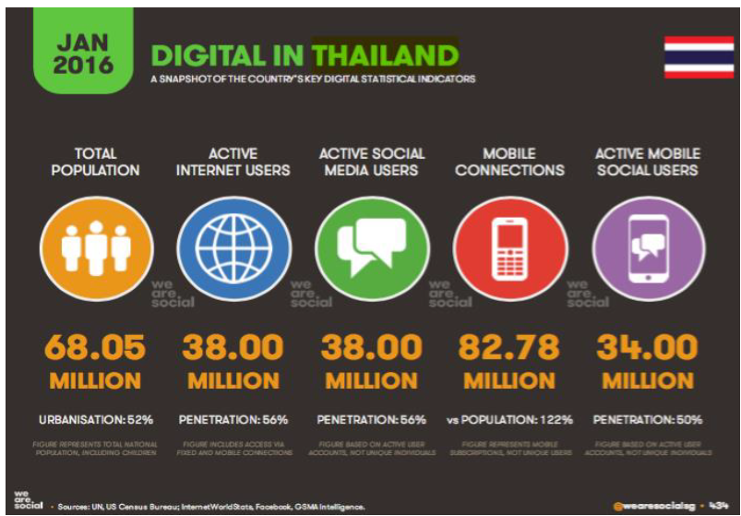
Digital statistics
Relatively high shares of active Internet and Social Media users. Same marketing approach as it is in other APAC countries will be applicable in Thailand.

Slide 9
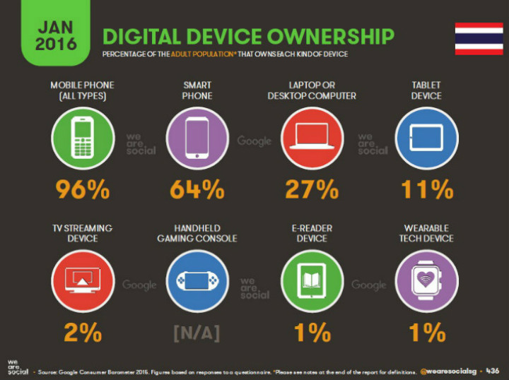
Digital devices penetration
High and further growing smartphone penetration together with absence of advertising constraints make the market very attractive for digital marketing.

Slide 10
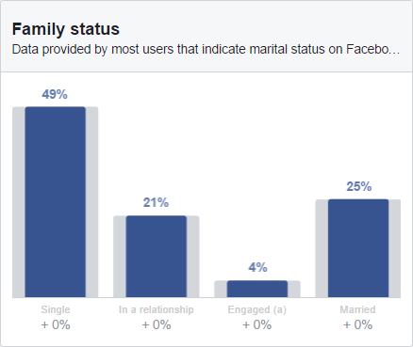
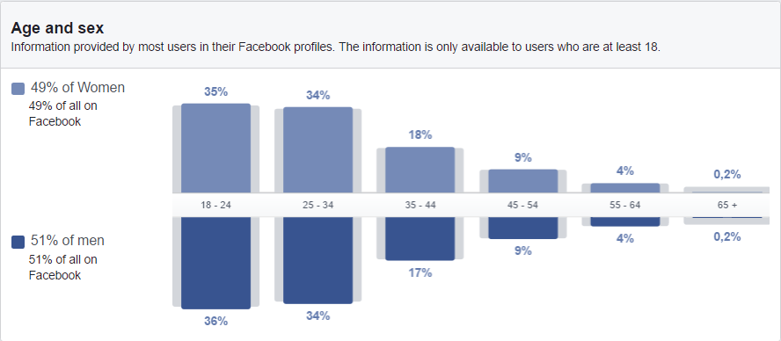
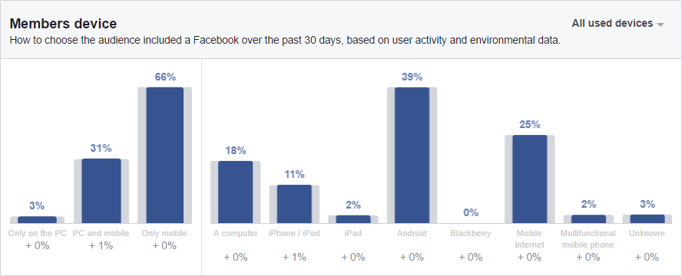
Facebook (FB) user details
The majority of Facebook users (equally men & women) are between the ages of 18 and 34 (70%), 75% are not married.
Predominantly (66%) people use mobile devices to access FB content. Android is commonly widespread, mobile web is also popular way of accessing social media in Thailand.

Slide 11
Annex 1: Markets comparison
Country statistics | VN | SG | PH | ID | MY | LK | TH
Population, mln | 91 | 5,5 | 101,9 | 255 | 31 | 21 | 67
GDP per capita (nominal), thsd USD | 2,3 | 56,3 | 3,2 | 3,5 | 12,2 | 3,9 | 5,7
GDP per person employed, thsd USD | 9,3 | 140,5 | 17,1 | 21,9 | 55,7 | 26,0 | 10,3
Labor force ratio | 62% | 68% | 63% | 67% | 66% | 42% | 58%
Average monthly salary, USD | 200 | 3 800 | 208 | 250 | 961 | 500 | 395
Smartphone penetration | 20% | 97% | 50% | 25% | 63% | 41% | 60%
Bank account penetration | 21% | 98% | 27% | 20% | 66% | 83% | 72%
Volume indicators (year 5) | VN | SG | PH | ID | MY | LK | TH
Loans issued in year 5, thsd including prolongations | 1 291 | 67 | 441 | 464 | 198 | 473
Loans issued per day in year 5 including prolongations | 3537 | 184 | 1208 | 1271 | 542 | 1576
Investment parameters | VN | SG | PH | ID | MY | LK | TH
Investment, mln USD | 15,7 | 9,2 | 8,8 | 11,0 | 8,6 | 2,8
Break-even period, months | 15 | 18 | 20 | 20 | 18 | 15
Payback period, months | 19 | 29 | 49 | 50 | 51 | 35
Revenue, (Year 5), mln USD | 71 | 28,5 | 42,2 | 53,9 | 37,3 | 24
Profit before taxes, (Year 5), mln USD | 19 | 9,5 | 15,5 | 16,8 | 15,3 | 6,2

Slide 12
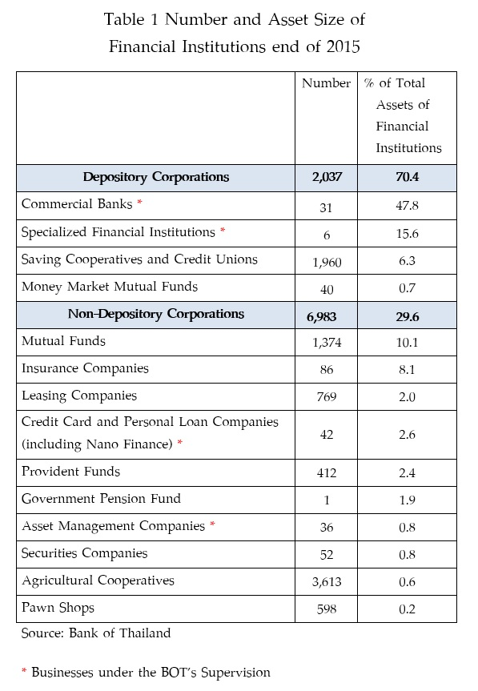
Financial Institutions. Number & Assets as of 2015

